Slide 1

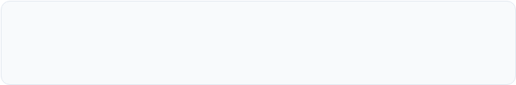
OTT STREAMING ANALYTICS
Department of Computer Science & Engineering
Aditya University
Contributors
Ch.Kusumitha Keerthi | Praveen Goswami | A. Aparajitha | K. Harsha Vardhan

Slide 2


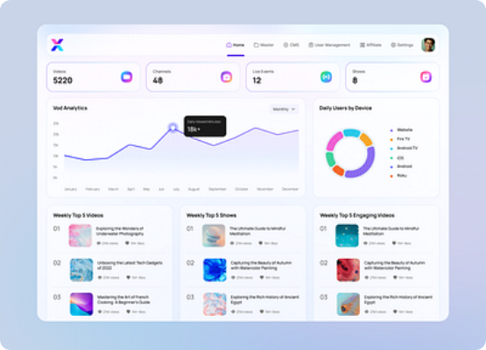
Problem Statement
Rapid Growth: The expansion of OTT platforms has drastically increased digital content and user engagement.
Data Management Challenge: Managing and analyzing massive volumes of streaming data is increasingly difficult.
Viewer Behavior: It is challenging to accurately understand complex viewer preferences and changing audience habits.
Recommendation Accuracy: A lack of robust data analysis directly affects the precision of content recommendations.
Business Impact: Poor insights can lead to ineffective content production strategies and suboptimal investment decisions.

Slide 3






Project Objectives
Analyze Preferences
Examine Trends
Drive Decisions
Analyze OTT streaming data to understand viewer preferences and watching behavior, identifying popular genres, movies, and TV shows.
Examine content trends across different countries and release years, comparing performance using ratings, popularity, and engagement.
Create interactive visualizations to present key insights effectively, supporting data-driven decision-making and better recommendations.

Slide 4
Tech Stack
Python: Data cleaning, preprocessing, and analysis.
Pandas: Data manipulation and handling datasets.
NumPy: Numerical calculations and data processing.
Matplotlib & Seaborn: Creating static charts and visualizations.
Power BI: Interactive dashboards and visual data exploration.
Excel / CSV: Dataset storage and initial preparation.
Jupyter Notebook: Writing and executing Python analysis.
Git/GitHub: Project version control and code management.

Slide 5
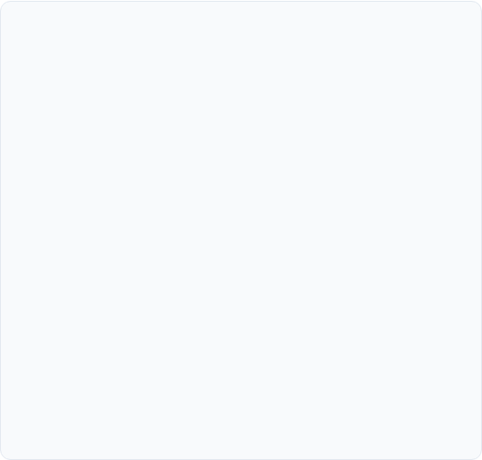
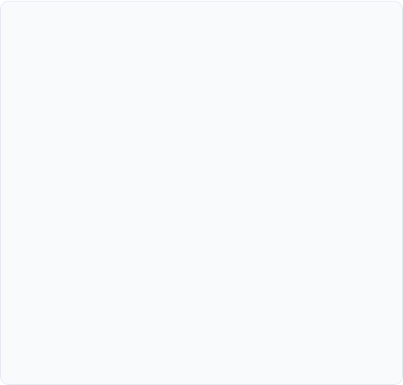
Dataset Details
Source & Scope
Attributes & Preparation
•
Data Sources: Cleaned datasets from Netflix, Amazon Prime Video, and Disney+.
•
Key Attributes: Title, Type, Genre, Release Year, Country, Language, Rating, Popularity, Vote Count, Budget, Revenue, and Duration.
•
Total Records: Over 34,000+ OTT movies and TV shows analyzed.
•
Data Preparation: Handled missing values, removed duplicate records, and standardized columns to ensure optimal data quality.
•
Platform Breakdown:
- Netflix: 31,991 records
- Disney+: 1,447 records
- Amazon Prime: 1,000 records
•
Purpose: Used to analyze viewer trends, content performance, and audience preferences via interactive dashboards.
•
Content Types: Includes both Movies and TV Shows.

Slide 6
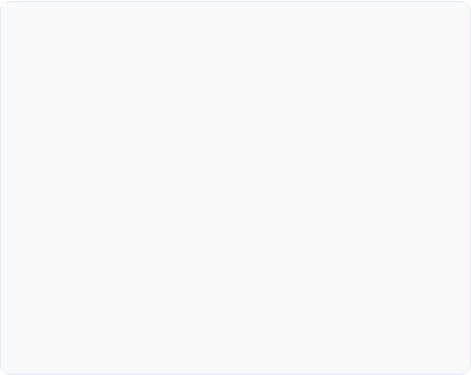
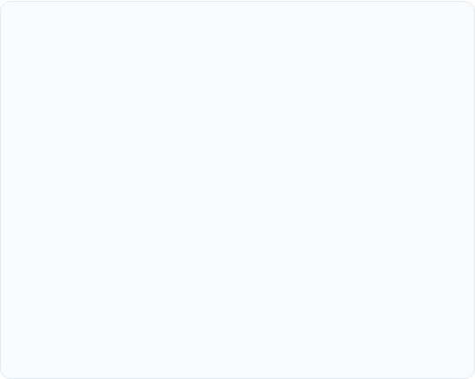
System Requirements
Hardware
Software
Processor: Intel Core i3 or equivalent and above
OS: Windows 10/11, Linux, or macOS
RAM: Minimum 4 GB; 8 GB recommended
Programming: Python 3.x
Storage: Minimum 10 GB of free space
Data Tools: Pandas, NumPy, Matplotlib, Seaborn
Display: 1366 × 768 resolution or higher
Environment: Google Colab or VS Code
Internet: Stable connection for downloading tools
Browser: Google Chrome, Microsoft Edge, or equivalent

Slide 7
Future Enhancements
Real-Time Analytics: Analyze viewer activity and streaming trends in real time.
AI-Based Recommendations: Use Machine Learning to provide highly personalized content recommendations.
Predictive Analytics: Predict future viewer preferences, popular genres, and content demand.
Sentiment Analysis: Analyze user reviews and feedback to understand audience satisfaction levels.
Advanced User Segmentation: Group viewers based on interests, location, viewing habits, and preferences.
Cross-Platform Analysis: Compare content performance dynamically across multiple OTT platforms.

Slide 8
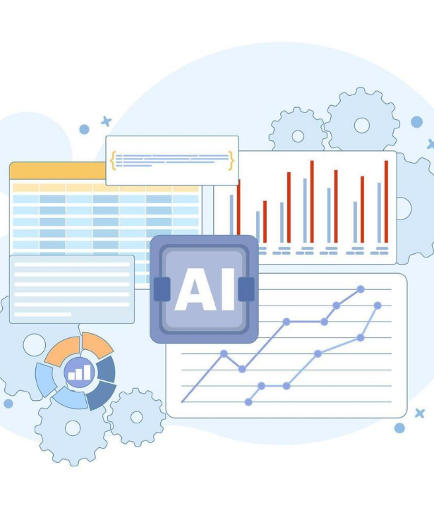
Conclusion
The project successfully analyzes OTT streaming data to identify important viewing trends, popular genres, top-rated content, and audience preferences.
Interactive dashboards make complex streaming data easy to understand and interpret, providing useful insights into viewer behavior and regional preferences.
Overall, OTT Streaming Analytics demonstrates how data-driven insights can support better content recommendations, improve user satisfaction, and help platforms make decisions about content creation and investment.

Slide 9

Thank You!
Any Questions?
Project Contributors
Ch.Kusumitha Keerthi | Praveen Goswami | A.Aparajitha | K. Harsha Vardhan

